Slide 1
Deep Learning from Scratch
Theory + Practical
FAHAD HUSSAIN
MCS, MSCS, DAE(CIT)
Computer Science Instructor of well known international Center
Also, Machine Learning and Deep learning Practitioner
For further assistance, code and slide https://fahadhussaincs.blogspot.com/
YouTube Channel : https://www.youtube.com/fahadhussaintutorial

Slide 2
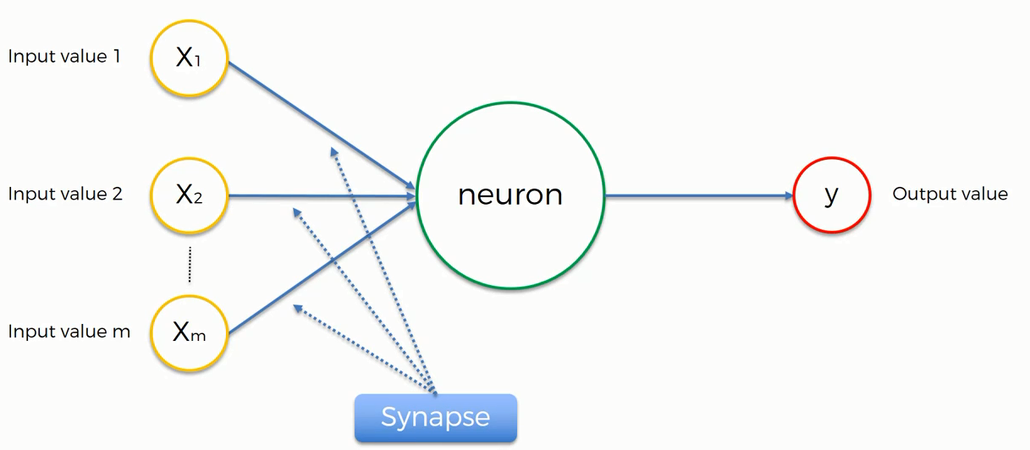

Artificial Neural Network
Normalize/Standardize
$$\sum_{i=x}^{m}{wi xi}$$
Applying Activation Function
For further assistance, code and slide https://fahadhussaincs.blogspot.com/
YouTube Channel : https://www.youtube.com/fahadhussaintutorial

Slide 3
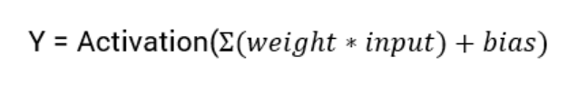
What is an Activation Function?
Activation functions are an extremely important feature of the artificial neural networks. They basically decide whether a neuron should be activated or not. Whether the information that the neuron is receiving is relevant for the given information or should it be ignored.
The activation function is the non linear transformation that we do over the input signal. This transformed output is then seen to the next layer of neurons as input.
Linear Activation Function
Non Linear Activation Function
For further assistance, code and slide https://fahadhussaincs.blogspot.com/
YouTube Channel : https://www.youtube.com/fahadhussaintutorial

Slide 4
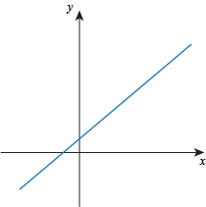
What is an Activation Function?
Linear Function
The function is a line or linear. Therefore, the output of the functions will not be confined between any range
Non Linear Function
Threshold
Sigmoid
Tanh
ReLU
Leaky ReLU
Softmax
They make it easy for the model to generalize or adapt with variety of data and to differentiate between the output
The Nonlinear Activation Functions are mainly divided on the basis of their range or curves
For further assistance, code and slide https://fahadhussaincs.blogspot.com/
YouTube Channel : https://www.youtube.com/fahadhussaintutorial

Slide 5
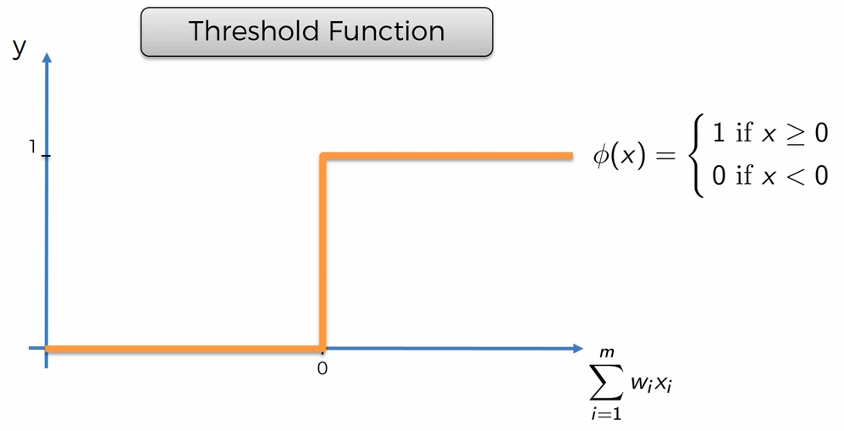
Threshold Function?
For further assistance, code and slide https://fahadhussaincs.blogspot.com/
YouTube Channel : https://www.youtube.com/fahadhussaintutorial

Slide 6
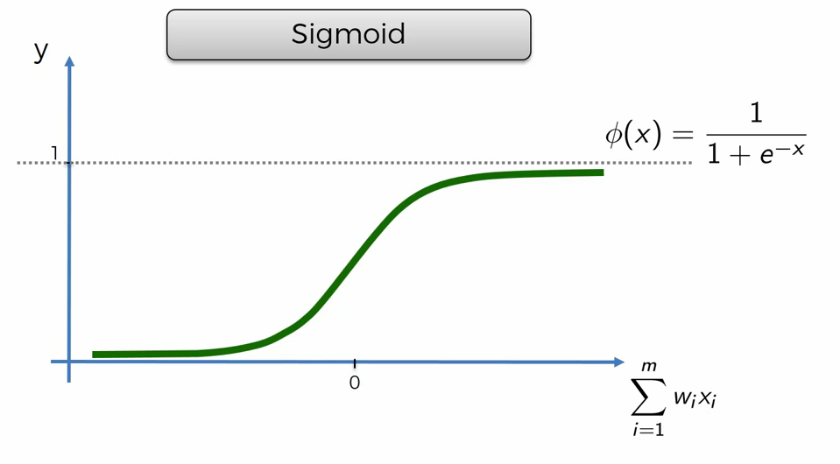
Sigmoid Function?
The Sigmoid Function curve looks like a S-shape
This function reduces extreme values or outliers in data without removing them.
It converts independent variables of near infinite range into simple probabilities between 0 and 1, and most of its output will be very close to 0 or 1.
For further assistance, code and slide https://fahadhussaincs.blogspot.com/
YouTube Channel : https://www.youtube.com/fahadhussaintutorial

Slide 7
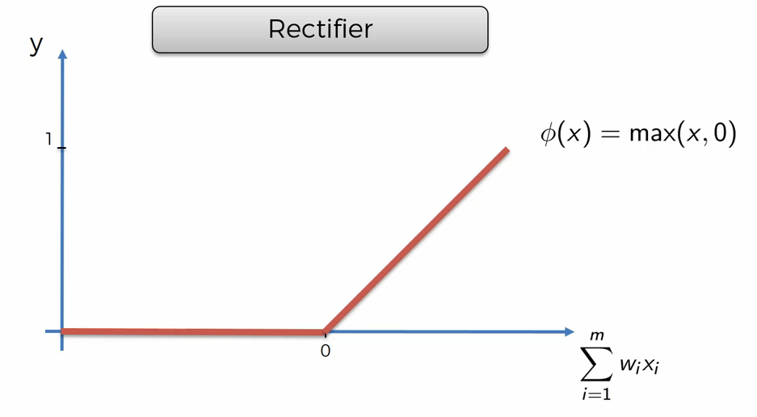
Rectifier (Relu) Function?
ReLU is the most widely used activation function while designing networks today. First things first, the ReLU function is non linear, which means we can easily backpropagate the errors and have multiple layers of neurons being activated by the ReLU function.
For further assistance, code and slide https://fahadhussaincs.blogspot.com/
YouTube Channel : https://www.youtube.com/fahadhussaintutorial

Slide 8
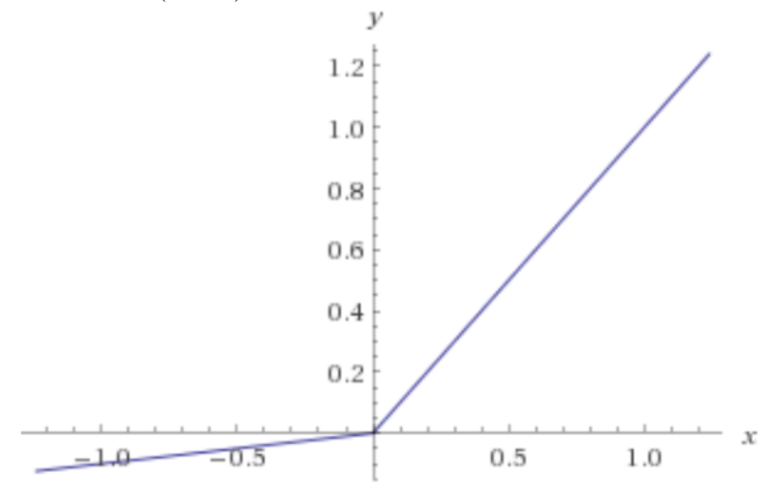
Leaky Relu Function?
Leaky ReLU function is nothing but an improved version of the ReLU function. As we saw that for the ReLU function, the gradient is 0 for x<0, which made the neurons die for activations in that region. Leaky ReLU is defined to address this problem. Instead of defining the Relu function as 0 for x less than 0, we define it as a small linear component of x.
What we have done here is that we have simply replaced the horizontal line with a non-zero, non-horizontal line. Here a is a small value like 0.01 or so.
For further assistance, code and slide https://fahadhussaincs.blogspot.com/
YouTube Channel : https://www.youtube.com/fahadhussaintutorial

Slide 9
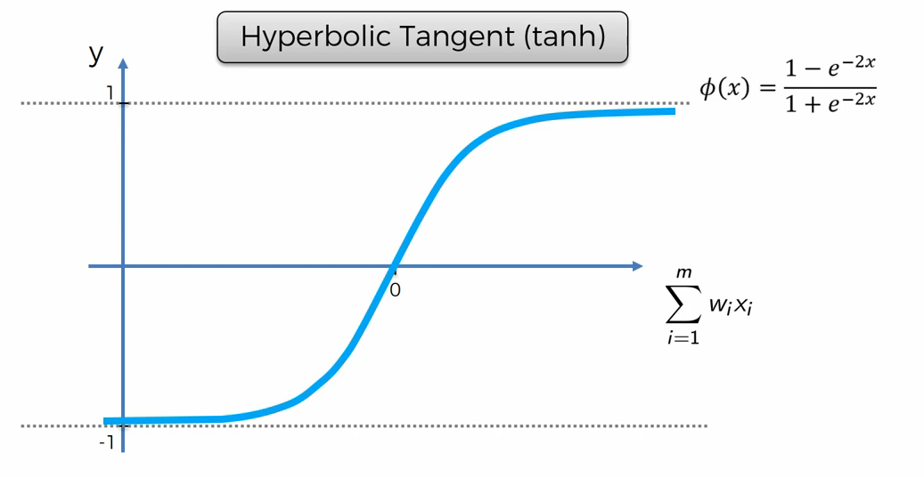
Sigmoid Function?
Pronounced “tanch,” tanh is a hyperbolic trigonometric function
The tangent represents a ratio between the opposite and adjacent sides of a right triangle, tanh represents the ratio of the hyperbolic sine to the hyperbolic cosine: tanh(x) = sinh(x) / cosh(x)
Unlike the Sigmoid function, the normalized range of tanh is –1 to 1 The advantage of tanh is that it can deal more easily with negative numbers
For further assistance, code and slide https://fahadhussaincs.blogspot.com/
YouTube Channel : https://www.youtube.com/fahadhussaintutorial

Slide 10
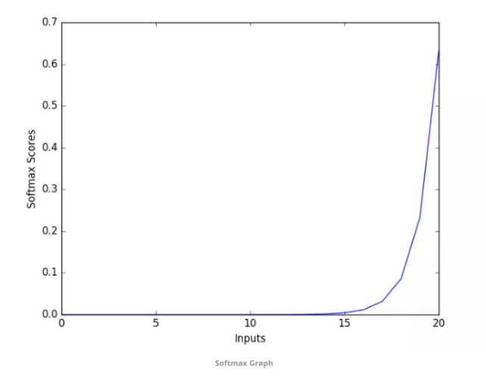
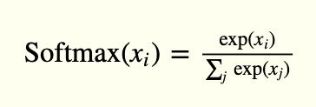
Softmax Function (for Multiple Classification)?
Softmax function calculates the probabilities distribution of the event over ‘n’ different events. In general way of saying, this function will calculate the probabilities of each target class over all possible target classes. Later the calculated probabilities will be helpful for determining the target class for the given inputs.
The main advantage of using Softmax is the output probabilities range. The range will 0 to 1, and the sum of all the probabilities will be equal to one. If the softmax function used for multi-classification model it returns the probabilities of each class and the target class will have the high probability.
The formula computes the exponential (e-power) of the given input value and the sum of exponential values of all the values in the inputs. Then the ratio of the exponential of the input value and the sum of exponential values is the output of the softmax function.
For further assistance, code and slide https://fahadhussaincs.blogspot.com/
YouTube Channel : https://www.youtube.com/fahadhussaintutorial

Slide 11
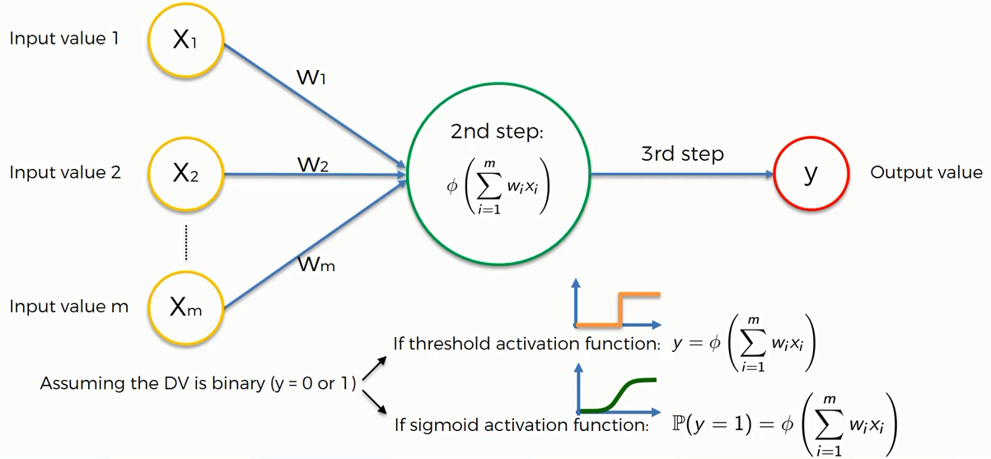
Activation Function Example
For further assistance, code and slide https://fahadhussaincs.blogspot.com/
YouTube Channel : https://www.youtube.com/fahadhussaintutorial

Slide 12
Thank You!
For further assistance, code and slide https://fahadhussaincs.blogspot.com/
YouTube Channel : https://www.youtube.com/fahadhussaintutorial

